Slide 1
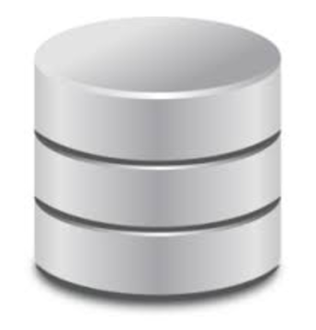
DTO
(VO,Model)
5
Controller
View
Service
DAO
1
2
3
4

Slide 2
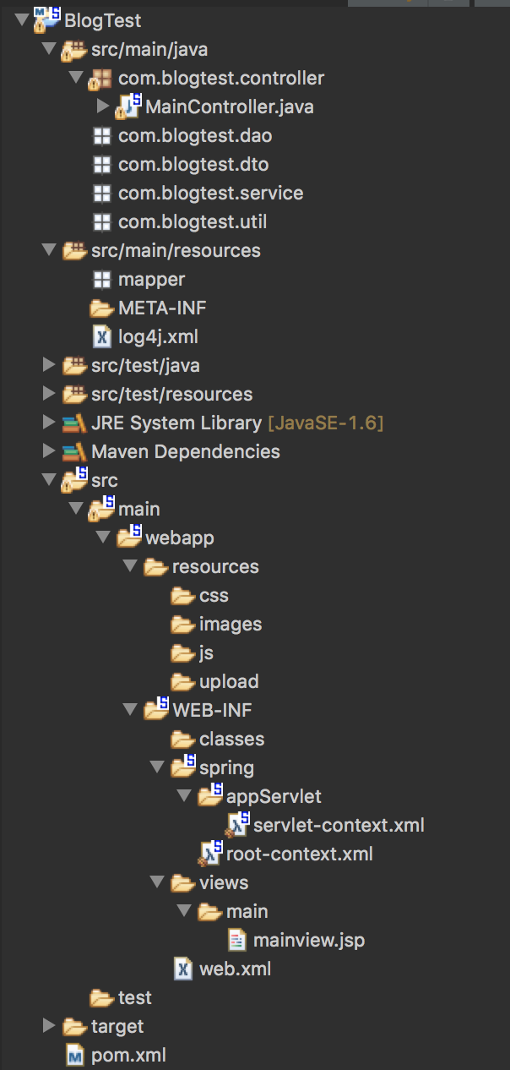
7
6
5
4
3
2
1

Slide 3

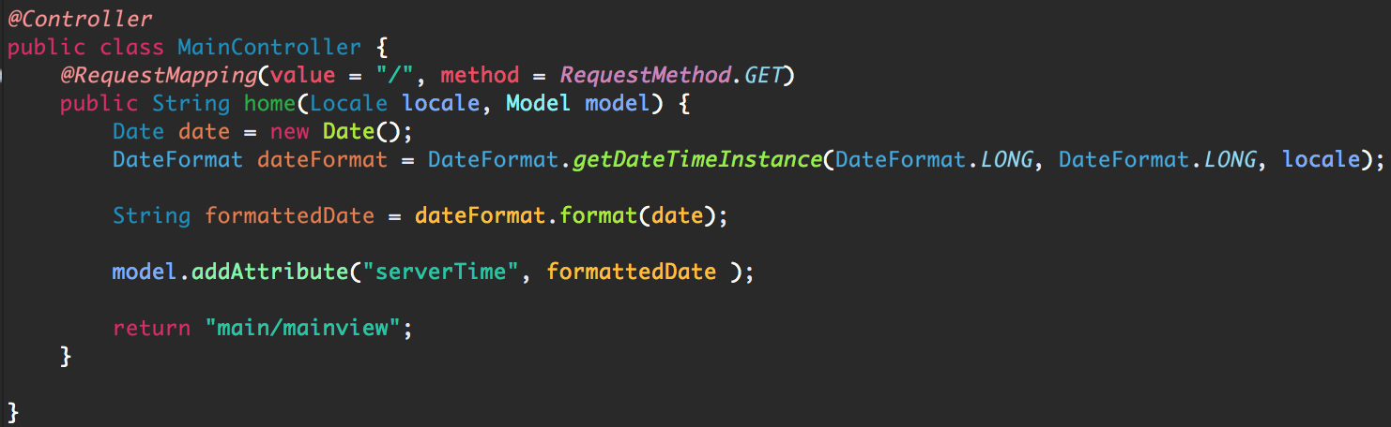

뷰 관련 설정 및 서비스 호출

Slide 4
일반적인 구조
Spring Framework
Heap Memory Space
Heap Memory Space
Obj 1
Obj 2
Obj 3
Obj 1
Thread 1
Thread 2
Thread 3
Thread 1
Thread 2
Thread 3

Slide 5
DTO
(VO,Model)
5
Controller
View
Service
DAO
1
2
3
4

Slide 6
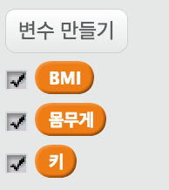




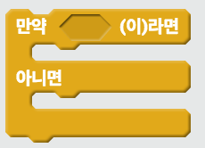

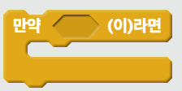






1
2
3
4
5
6
7
8
9
10
11

Slide 7
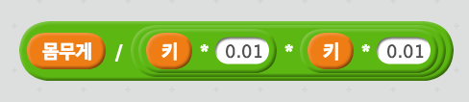
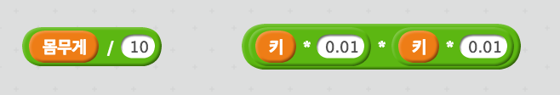
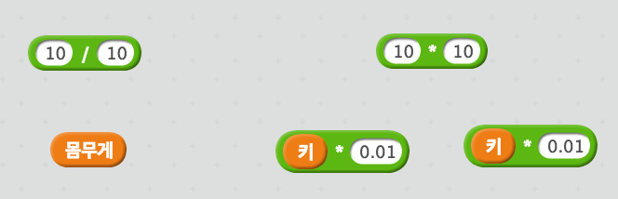
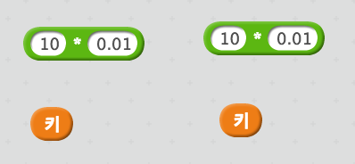

Slide 8

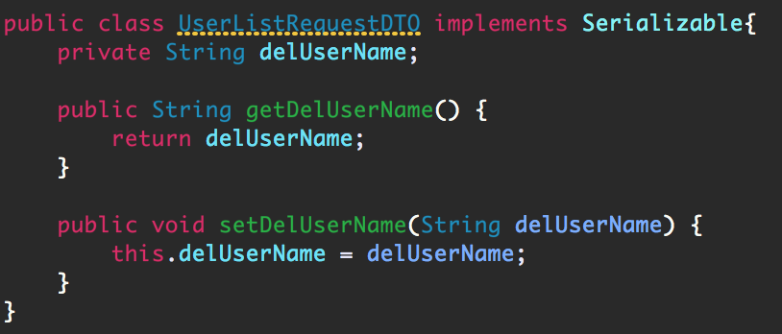
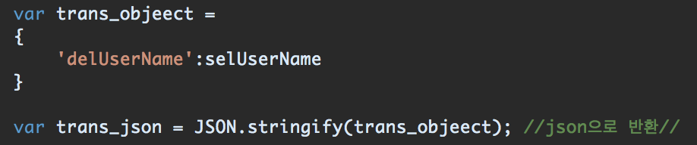
JSON

Slide 9
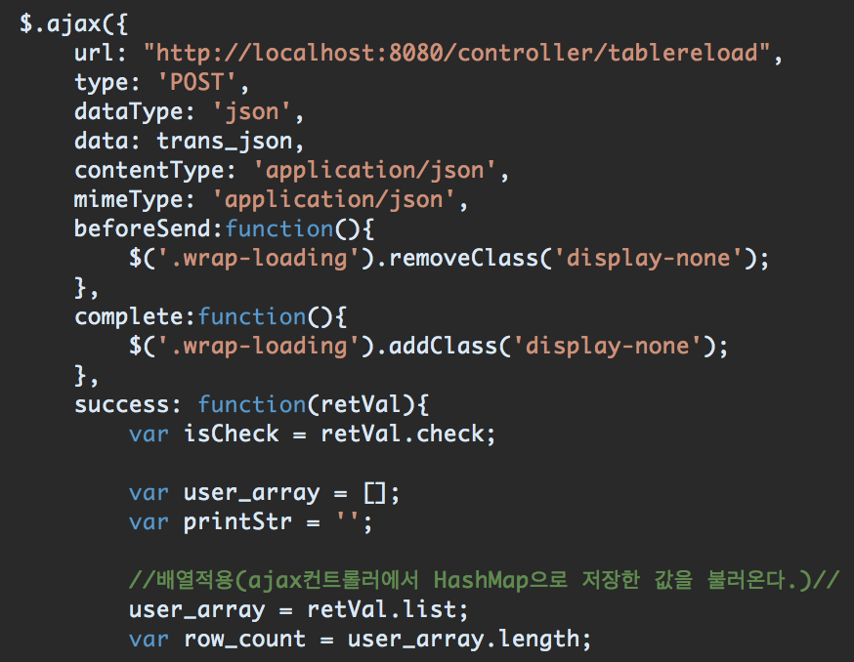
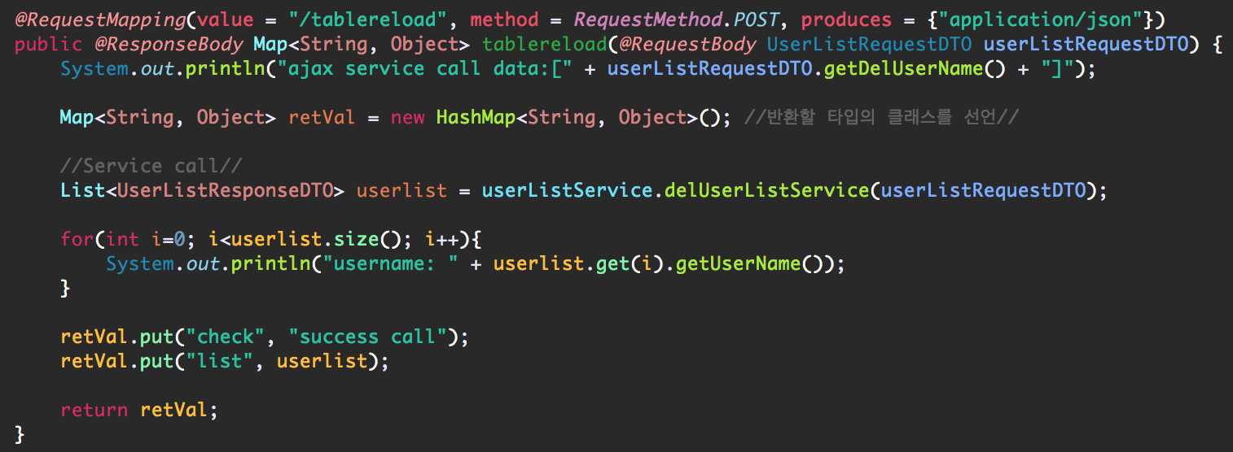
Server
Client

Slide 10
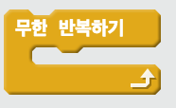




1
2
3
4
1

Slide 11


50 > 30
= 50
50>x (o)
50<x<100 (x)
40 > 30
= 40
40>x (o)
40<x<50 (x)
20 < 30
= 20
…….
…….
20>x (x)
20<x<30 (o)
30
=
정답!!

Slide 12

일반적인 Connection 구조
Spring Framework DBCP
Connection Resource
Connection Resource
Thread 1
Thread 2
Thread 3
Thread 1
Thread 2
Thread 3

Slide 13


SqlSessionTemplate
SqlSessionFactory
DataSource
DBCP
@Autowired

Slide 14
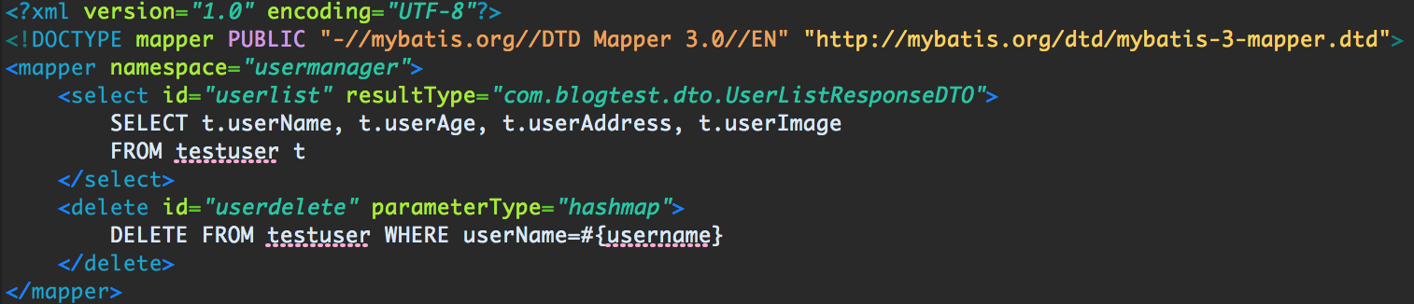
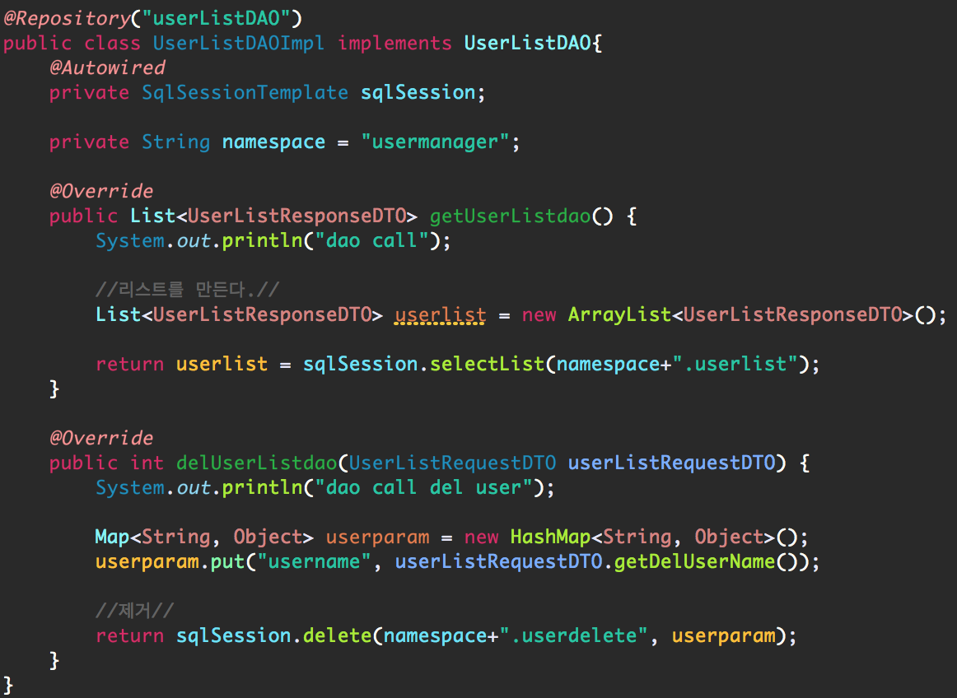
1
2

Slide 15
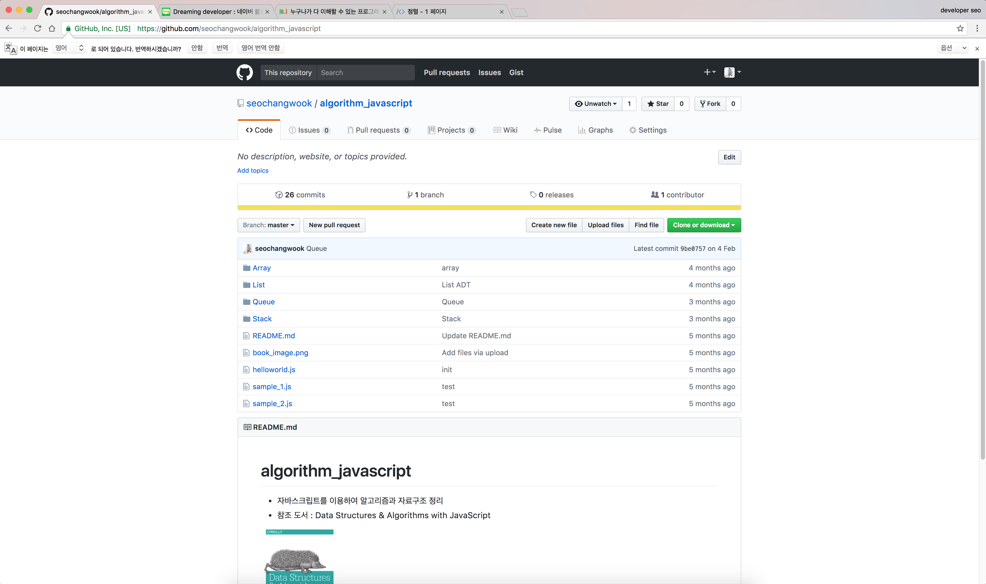
URL 공유

Slide 16
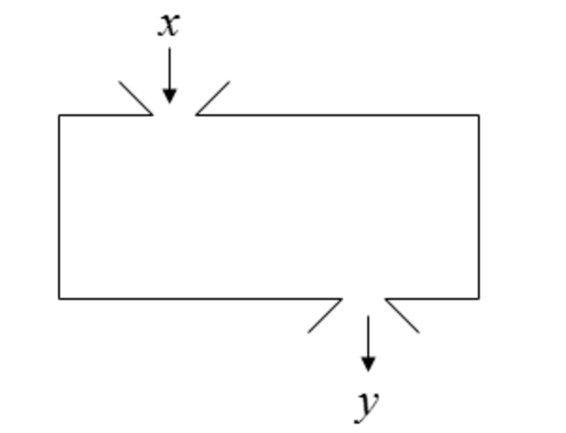
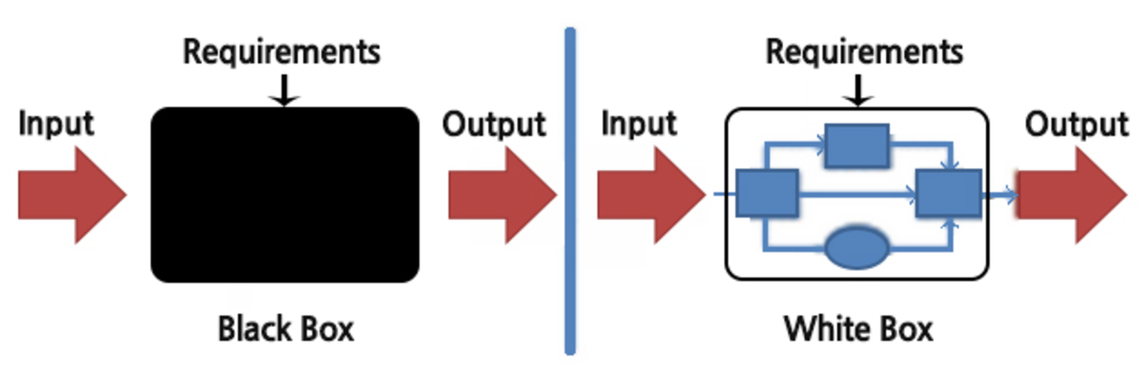
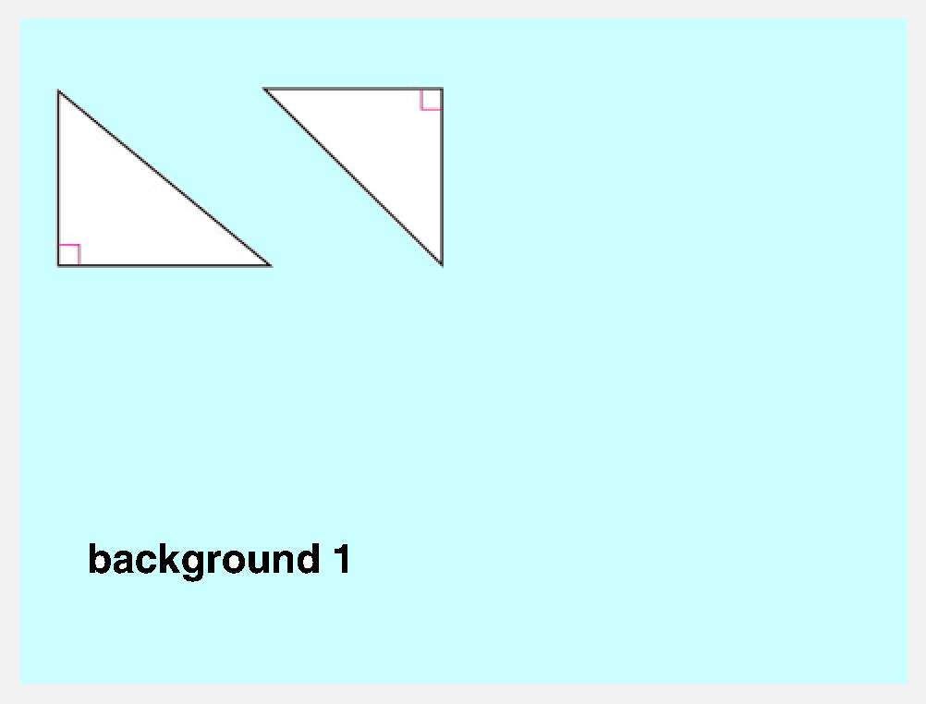
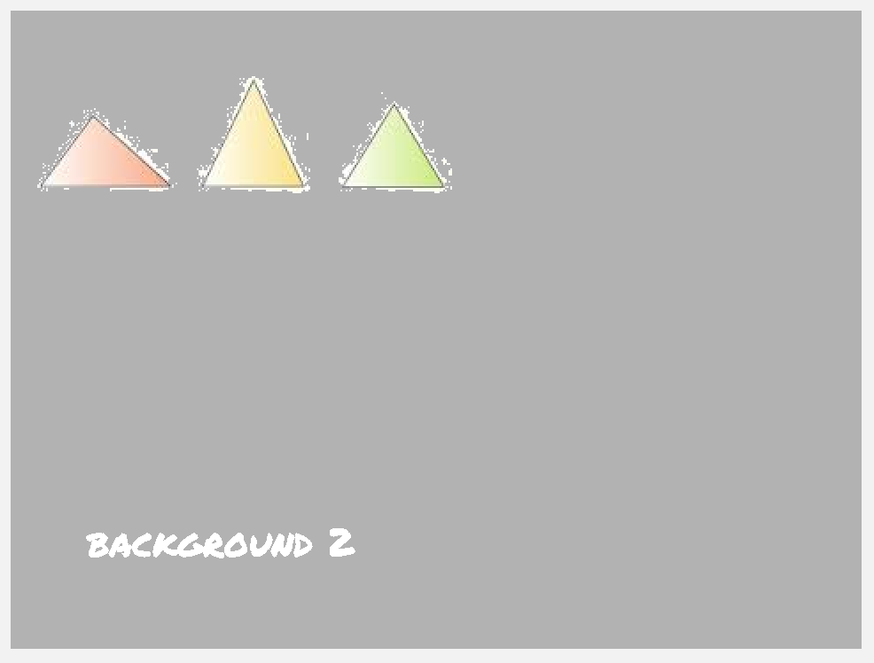
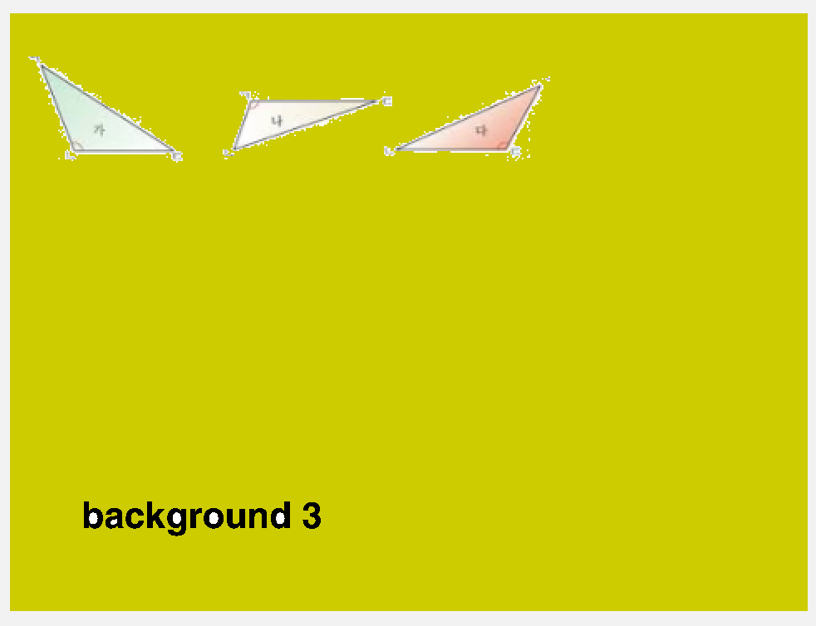
B
A
C
(1)
(2)

Slide 17
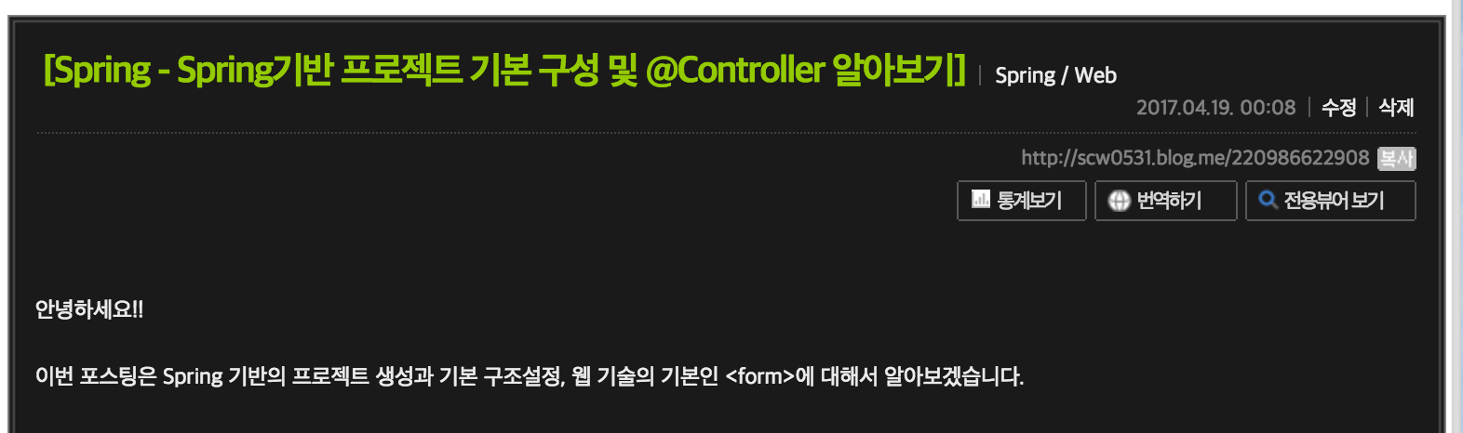
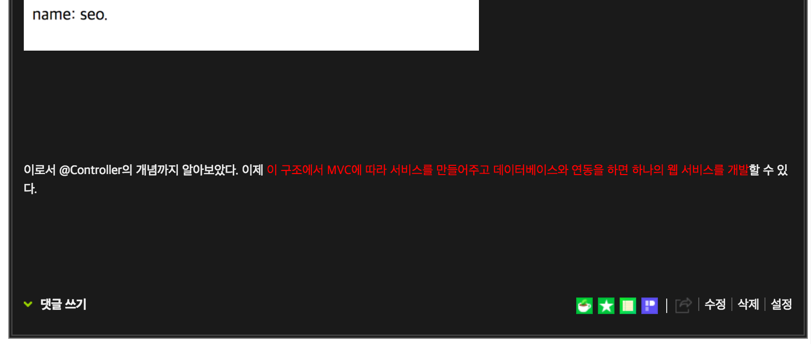
영상링크

